Slide 1
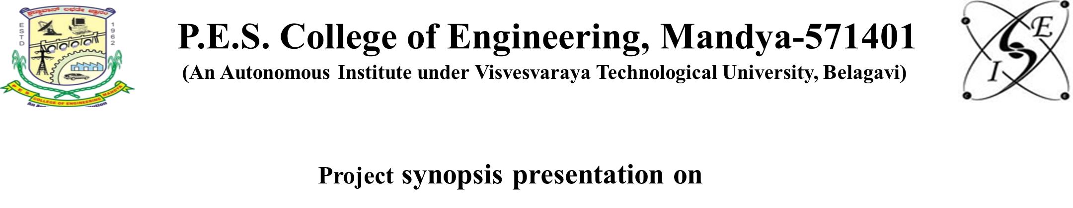
DEPARTMENT OF INFORMATION SCIENCE AND ENGINEERING
“MULTILINGUAL FAKE NEWS DETECTION SYSTEM WITH REAL-TIME WEB APPLICATION”
Presented by
Under the Guidence Of
Anand Reddy (4PS22IS005)
Dr.Suresh M R
Professor
Deptof IS&E
Kushal S(4PS22IS030)
Nuthan Gowda A P(4PS22IS038)
Ruchitha M R(4PS22IS044)

Slide 2


Problem Statements
Modern misinformation is no longer limited to plain text articles. Fake news now spreads through screenshots, manipulated headlines, social media posts, forwarded messages, and online news URLs across multiple platforms and languages. Existing detection systems mainly depend on standalone machine learning models, which are effective at identifying linguistic patterns but often fail to understand contextual meaning, factual inconsistency, and credibility signals.
To address these challenges, there is a need for a scalable hybrid AI-based system that combines machine learning, large language model reasoning, OCR-based text extraction, and confidence-based fusion techniques to provide accurate and explainable fake news detection for text, URLs, and images in real time

Slide 3
Project objectives
Develop a machine learning model capable of detecting fake news using Natural Language Processing techniques.
To classify news content as REAL or FAKE using machine learning and AI-based techniques.
To support multimodal news analysis through text, URL, and image inputs..
To improve prediction accuracy by combining ML classification with LLM-based contextual reasoning..
To provide reliable and explainable fake news verification through a scalable web application.

Slide 4
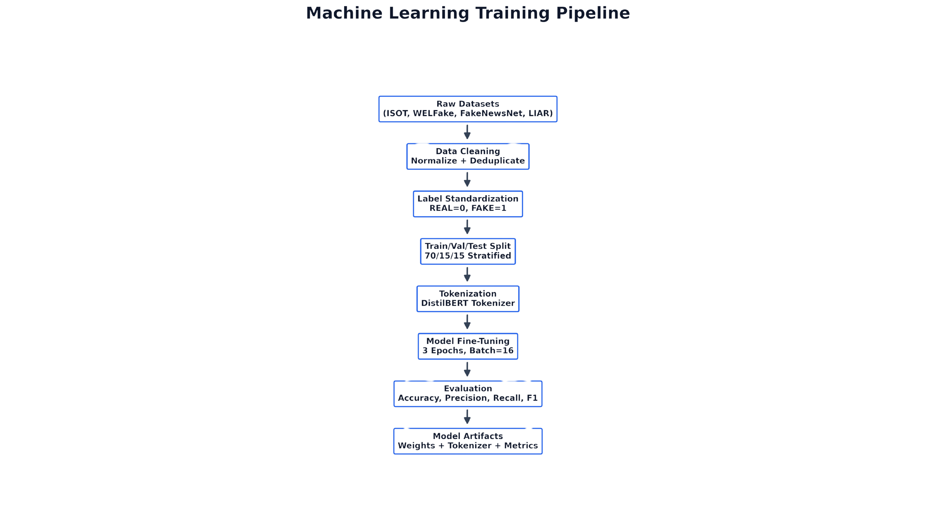

MODEL TRAINING PIPELINE
Collected and merged multiple benchmark fake news datasets including ISOT, WELFake, FakeNewsNet, and LIAR
Performed data preprocessing techniques such as cleaning, deduplication, normalization, and label standardization
Applied tokenization and transformer-based text encoding using the DistilBERT tokenizer
Split the processed dataset into training, validation, and testing sets using stratified sampling
Fine-tuned the multilingual DistilBERT model for binary fake news classification
Evaluated model performance using Accuracy, Precision, Recall, F1-Score, and Loss metrics
Generated optimized model checkpoints for real-time inference and prediction analysis

Slide 5
MACHINE LEARNING MODEL
Input news content is first tokenized using the DistilBERT tokenizer to convert text into transformer-readable embeddings
The transformer model analyzes semantic meaning, sentence relationships, writing patterns, and contextual misinformation indicators
Attention mechanisms inside DistilBERT identify important words and misleading linguistic patterns across the news content
The fine-tuned classification layer predicts whether the content belongs to the REAL or FAKE category
The model generates confidence probabilities which are forwarded to the fusion engine for weighted decision analysis
Final predictions are combined with LLM reasoning and credibility verification to improve overall detection reliability

Slide 6
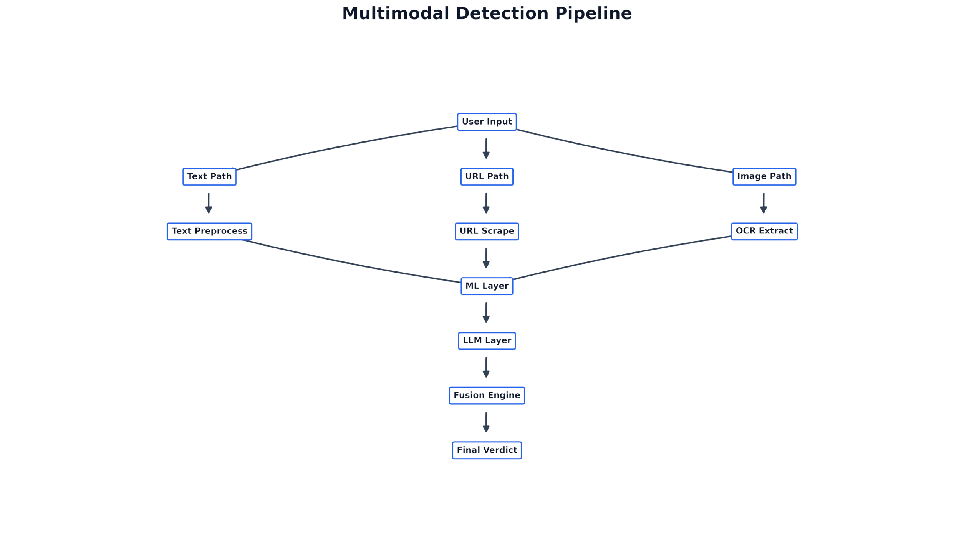
MULTIMODAL PIPELINE
Supports Text, URL, and Image-based news verification
Text input is processed through preprocessing and classification layers
URLs are scraped to extract article content for analysis
Images are processed using OCR for text extraction
All input paths are analyzed using ML and LLM layers
Fusion engine combines predictions to generate final verdict

Slide 7
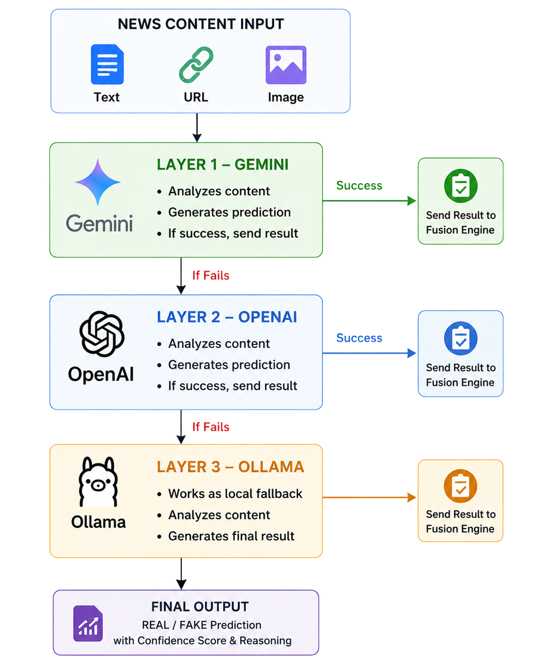
LLM Verification Layer Working
The news content is first sent to the Gemini AI model for verification
Gemini analyzes the news and generates prediction with reasoning
If Gemini fails or becomes unavailable, the system automatically switches to OpenAI
OpenAI performs the same contextual verification and prediction process
If both Gemini and OpenAI are unavailable, the system uses Ollama as a local fallback model
Ollama generates the final verification output offline
The prediction and confidence score are then sent to the Fusion Engine for final decision making

Slide 8
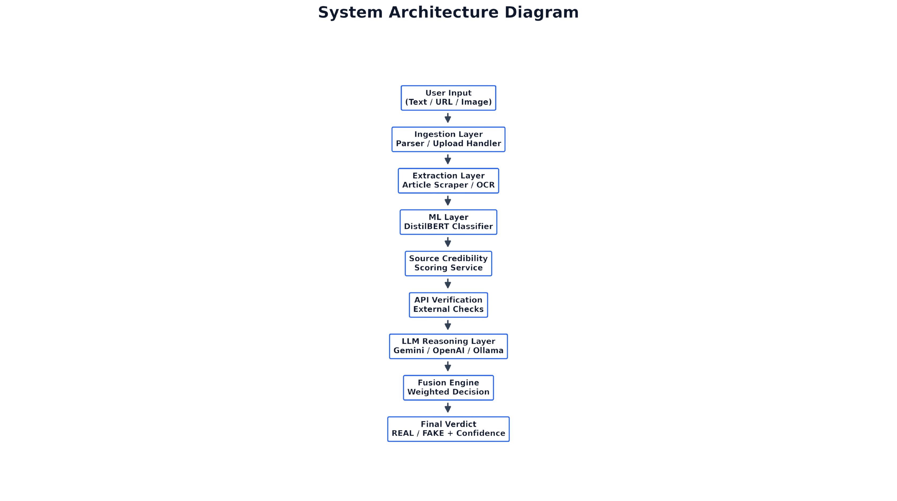
SYSTEM ARCHITECTURE
Accepts multimodal inputs such as Text, URL, and Images
Extracts content using URL scraping and OCR processing
Uses DistilBERT for fake news classification
Performs source credibility and API-based verification
Integrates LLM reasoning using Gemini, OpenAI, and Ollama
Applies a fusion engine for weighted decision making
Generates final REAL/FAKE verdict with confidence score

Slide 9

BACKEND SERVICE ARCHITECTURE
Developed backend services using Flask for real-time fake news analysis
Implemented REST APIs for text, URL, and image prediction requests
Integrated OCR, translation, ML, and LLM services into a unified pipeline
Connected MongoDB Atlas for storing prediction history and analytics
Enabled communication between frontend, backend, and AI models
Generated structured JSON responses with prediction and confidence results

Slide 10
Results & Performance Analysis
| Metric | Value |
| --------- | ----- |
| Accuracy | 91.5% |
| Precision | 91.1% |
| Recall | 87.9% |
| F1-Score | 0.895 |
The DistilBERT model achieved high classification accuracy on unseen fake news samples
The system successfully handled Text, URL, and Image-based news verification in real time
Combining ML prediction with LLM reasoning improved overall prediction reliability
The fusion engine produced more balanced and confidence-aware final decisions
Optimized inference pipeline enabled fast response generation for real-time analysis

Slide 11
Conclusion
Successfully developed a hybrid AI-based fake news detection system
Integrated Machine Learning, LLM reasoning, OCR, and fusion analysis into a single platform
Enabled real-time verification for Text, URL, and Image-based news content
Improved prediction reliability using confidence-based multi-layer analysis
Built a scalable and user-friendly web application for misinformation detection
Demonstrated the potential of Hybrid AI systems for reliable fake news verification

Slide 12
Reference
1.Ahmad K., Alam M. S., Kumar S.: Enhancing Fake News Detection with Transformer-based Models. IEEE Access 12, 15234–15248 (2024)
2. Zhang L., Wang H., Chen Y.: Survey on Deep Learning Approaches for Fake News Detection. IEEE TCSS 11(2), 892–908 (2024).
3. Patel R., Singh A., Gupta V.: BERT-based Ensemble for Multilingual Fake News Detection. IEEE Computer Society 18(4), 45–58 (2023).
4. Johnson M., Liu X., Thompson K.: Real-time Misinformation Detection Using Hybrid Architectures. IEEE TKDE 35(8), 7821–7834 (2023).
5. Rodriguez C., Kim J., Brown A.: Explainable AI for Social Media Content Verification. IEEE Intelligent Systems 39(1), 78–87 (2024).

Slide 13


Thank you

